Slide 1
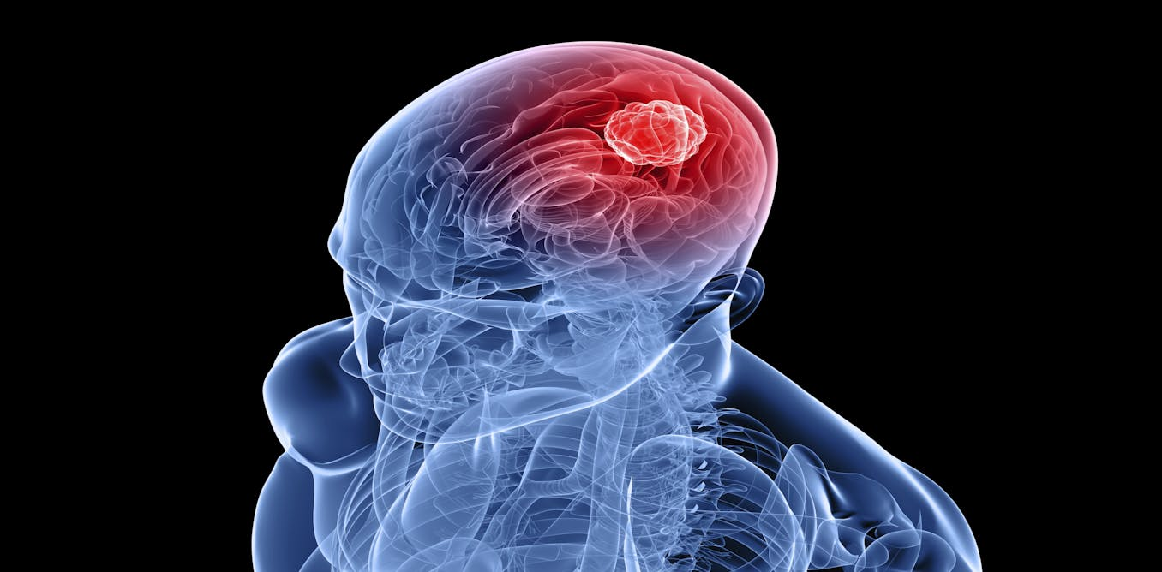

Brain Tumor Imaging Precision

Slide 2
Team members: 2110030009 – G. Vaishnavi 2110030056 – B. Akshita 2110030147 – G. Mahitha Christina 2110030457 – V. Charishma

Slide 3
Domain : Healthcare
Problem Statement
1. Physical symptoms of brain tumors differ among patients, and some individuals may not display any general symptoms.
2. MRI scans are considered more dependable than physical symptoms for diagnosing brain tumors.
3. The problem is framed as automatic detection and labeling of tumor regions pixel-wise from MRI scan images.
4. Previous approaches have relied on manually constructed features for tumor detection.
5. However, detecting tumors like gliomas and glioblastomas is challenging due to the rarity of discerning features.
6. Consequently, generic features are less effective for accurate detection in such cases.

Slide 4
Introduction
Healthcare, a vital domain for human well-being, faces ongoing challenges in diagnosing and treating brain tumors, necessitating advanced technologies and methodologies.
Significance:
1. Precision Diagnosis: Medical image segmentation, particularly in brain tumor cases, enables accurate identification and delineation of tumor regions, supporting clinicians in making informed diagnostic decisions.
2. Personalized Treatment Planning: Segmentation of brain tumor images facilitates the development of tailored treatment plans based on specific tumor characteristics and locations, optimizing therapeutic outcomes for patients.
3. Minimally Invasive Procedures: Effective segmentation techniques contribute to the advancement of minimally invasive surgical approaches, reducing patient discomfort and recovery time while enhancing surgical precision.
4. Improved Patient Outcomes: Timely and precise segmentation of brain tumor images leads to earlier detection, intervention, and monitoring, ultimately enhancing patient outcomes and quality of life in healthcare practice.

Slide 5
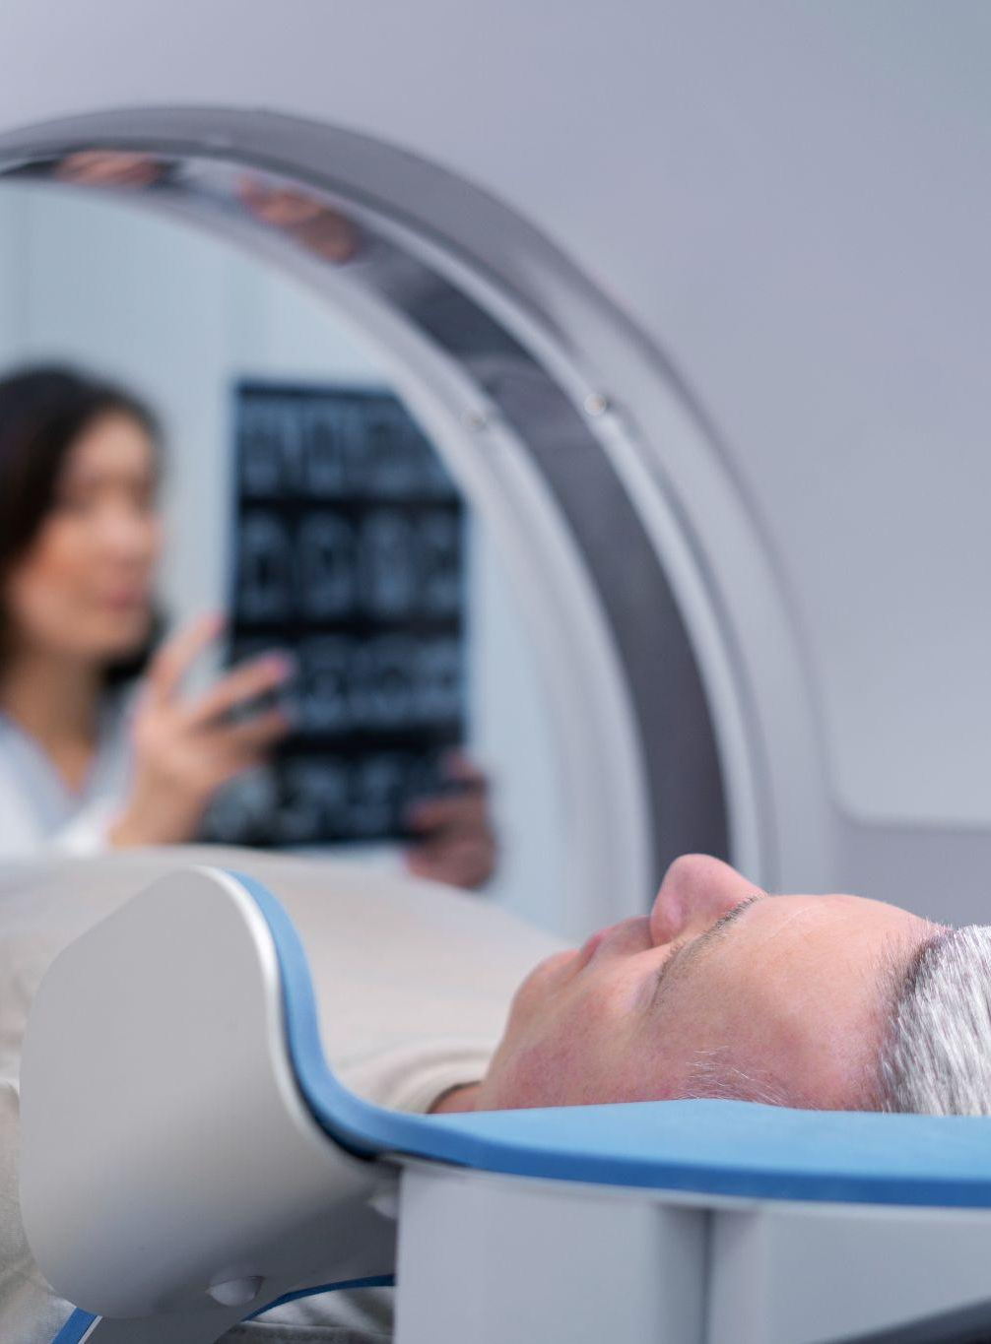
Solution BreakDown

Slide 6

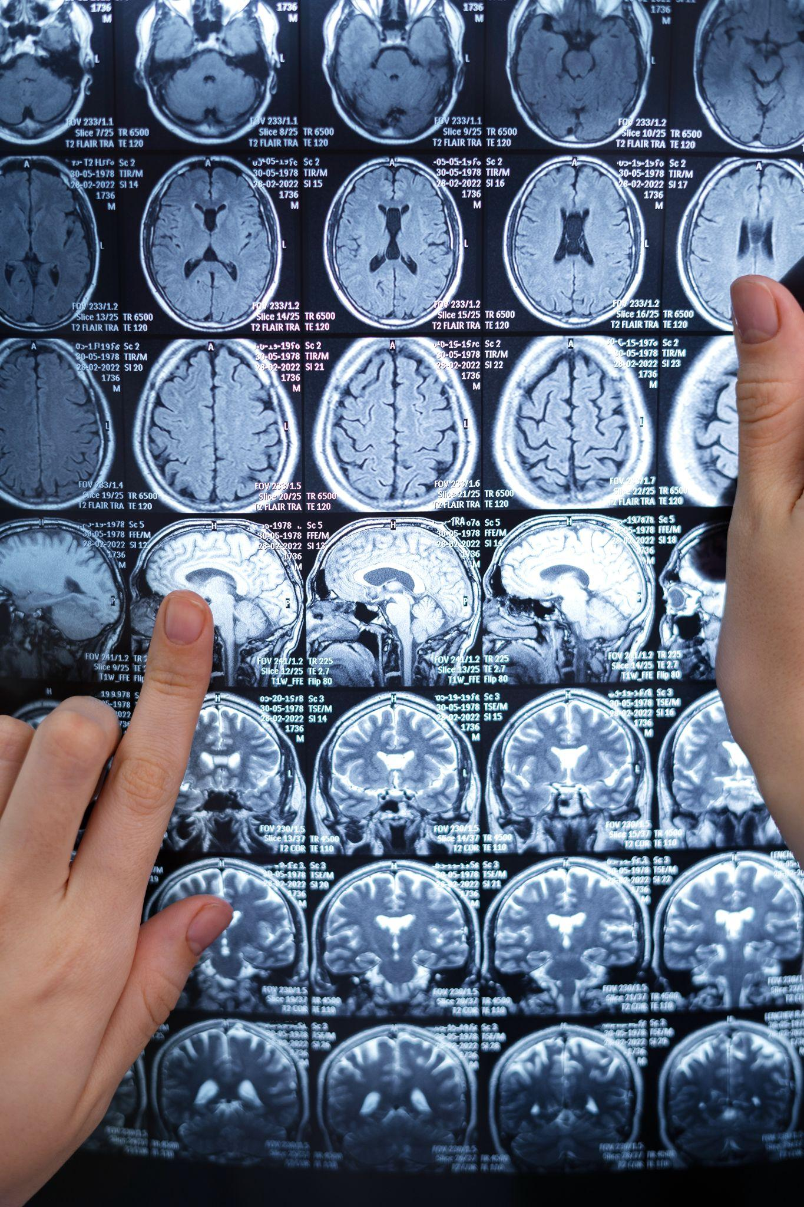
The proposed solution for automatic detection utilizes Support Vector Machines (SVM) for the automated identification and categorization of tumor areas in MRI scans. By analyzing a comprehensive dataset of brain images, it distinguishes various tumor types with high accuracy, thereby improving diagnostic accuracy. Given its proficiency in handling complex, multi-dimensional data, SVM is particularly suited for medical image analysis. This technique not only expedites the classification process but also enhances its dependability, which is vital for prompt and precise treatment strategies.

Slide 7
Benefits: 1. Automated Classification: Automates tumor classification, reducing reliance on manual expertise and potential biases. 2. Improved Efficiency: Can potentially process a large number of images quickly, aiding in faster diagnosis. 3. Objective Evaluation: Provides an objective assessment of tumor type based on image features, potentially leading to more consistent results.

Slide 8
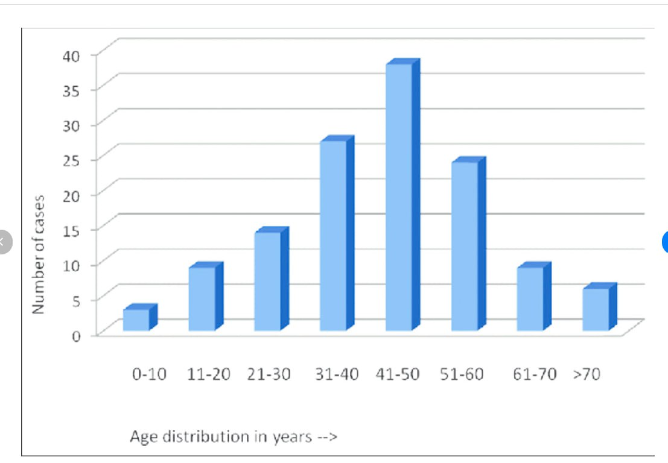
Age distribution of brain tumor cases

Slide 9
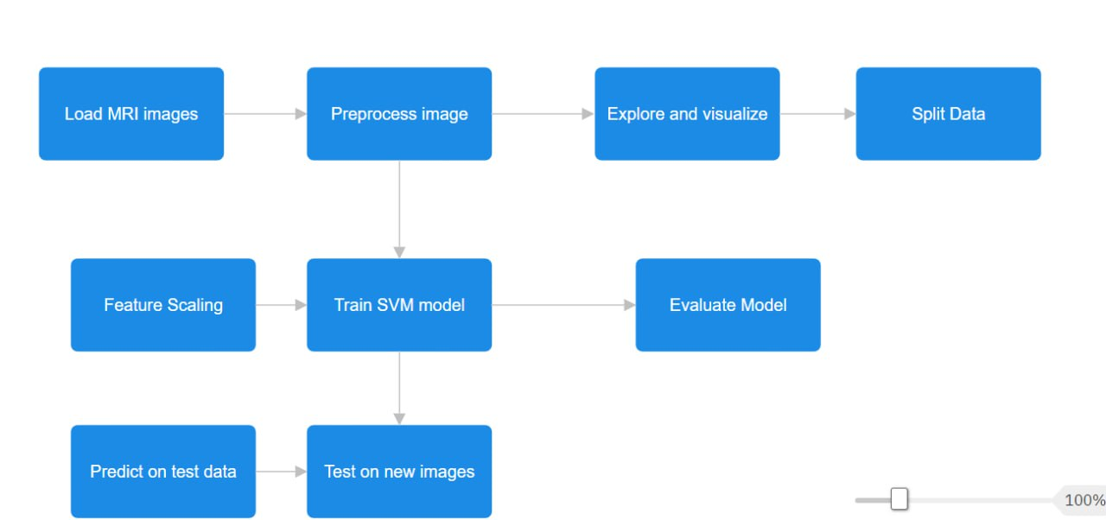
Flow Chart

Slide 10
Implementation
1. Data Loading and Preprocessing:
Loads brain tumor images from designated folders.
Converts images to grayscale and resizes them to a uniform size.
Flattens the image data into a 2D array for model compatibility.
2. Data Exploration and Visualization:
Analyzes the distribution of labels (e.g., number of images per tumor type).
Optionally visualizes sample images to understand the data characteristics.
3. Data Preparation:
Splits the data into training and testing sets using train_test_split.
Normalizes pixel values between 0 and 1 for better model convergence (feature scaling).

Slide 11
4. Model Training:
Trains an SVM model using the training data. This model learns to differentiate between different tumor types based on the image features.
5. Model Evaluation:
Evaluates the trained model's performance on the testing set using metrics like accuracy. This helps assess how well the model generalizes to unseen data.
6. Prediction on New Images:
Allows prediction of tumor types for new brain images not included in the training set. This demonstrates the model's ability to classify in real-world scenarios.

Slide 12
Conclusion
In summary, the proposed solution leverages Support Vector Machines (SVM) for automating brain tumor classification using MRI scans. It facilitates data loading, preprocessing, and exploration, aiding in understanding label distributions. The model is trained to differentiate tumor types based on image features and evaluated for performance using metrics like accuracy. Its benefits include automated classification, potentially reducing manual biases and expediting diagnosis. However, further optimization in SVM parameters and feature selection techniques could enhance its performance. Ultimately, the solution offers an effective framework for accurate and robust tumor detection, enhancing diagnosis and treatment planning for patients with brain tumors.

Slide 13
THANK YOU

